Slide 1


Building Models
Selecting the modeling method
Selecting the covariates/predictors (“model selection”)
Optimizing the coefficients/parameters of the model (“parameter estimation”)
9bytez.com:Old School Hobbies: Building Models by Hand

Slide 2
Regression Modeling Approaches
We’re about to explore approaches to regression/covariate modeling:
  GLM: Generalized Linear Models
  GAM: Generalized Additive Models
  CART: Classification and Regression Trees
  HEMI 2: Hyper-envelope Modeling Interface
  MaxEnt: Maximum Entropy

Slide 3
Response Drives the Method
Occurrences only (point density):
  Habitat: MaxEnt, HEMI 2
  Density estimators, clustering
Binary (presence/absence):
  GLM(logistic), CART
Categorical:
  CART, GAM?
Continuous:
  Linear Regression: Linear
  GAM: Virtually any continuous

Slide 4
GLM:
  Response: Binary or Continuous (known function: linear, binomial…)
  Covariates: Continuous
GAM:
  Response: Virtually any continuous or Categorical
  Covariates: Continuous and/or Categorical
CART:
  Response: Categorical, Continuous?
  Covariates: Categorical or Continuous
HEMI 2 & MaxEnt:
  Response: Occurrences (points)
  Covariates: Continuous (typical) or Categorical

Slide 5

Context for Evaluation
What is the purpose of our model?
How will we explain the results and how they should be interpreted and used?
Who will use the model or its outputs?
mobilemonitoringsolutions.com

Slide 6
How Good is the Model?
Does it make sense to you and experts in the topic?
Do the predictions make sense?
Does it hold up to validation?
Is the uncertainty acceptable?
Is it overly sensitive?

Slide 7
How Good is a Model?
Performance Metrics
  AIC, AICc, BIC
  Also:
    Number of parameters
    Likelihood
    RMSE/RMSD
Response curves with sample data
  Confidence intervals
Residual histograms with:
  Min, max, mean, standard deviation
These methods only test within the domain of the data

Slide 8
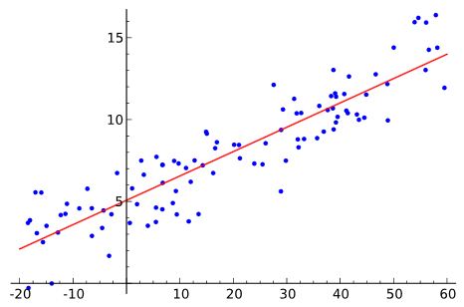
Response Curves
Extrapolation
Prediction
From model
Response
Curve
Modeling: Creating a model that allows us to estimate values between data
Extrapolation: Using existing data to estimate values outside the range of our data

Slide 9
Residual Evaluation
Histograms:
  Normally distributed?
  Mean – 0?
  Standard Deviation – what is the “spread of the residuals”
  Do these describe the full range of sample values?
Do not work with all methods!

Slide 10
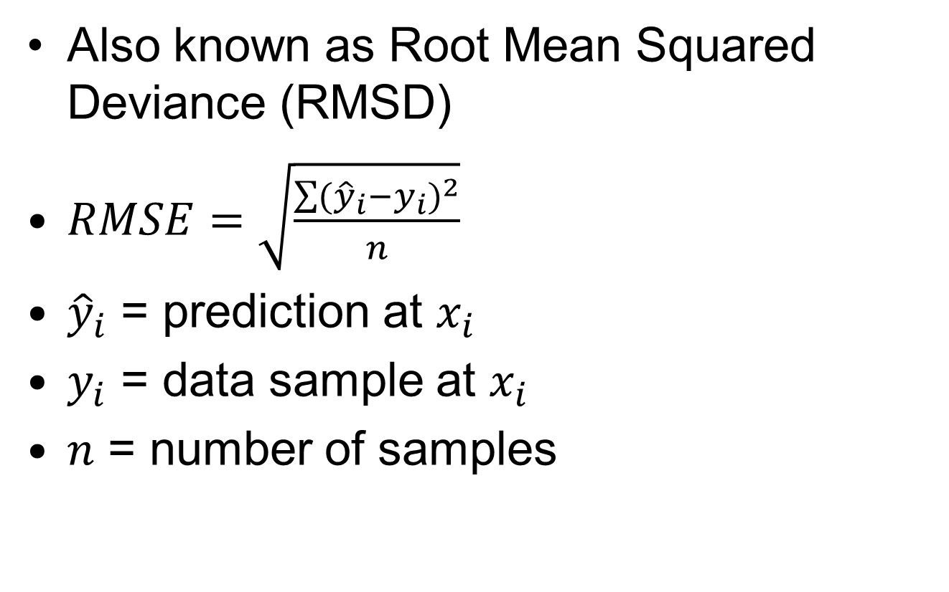
Root Mean Squared Error
Also known as Root Mean Squared Deviance (RMSD)
$RMSE=\sqrt{\frac{\sum{{({\hat{y}}_{i}−y_{i})}^{2}}}{n}}$
${\hat{y}}_{i}$ = prediction at $x_{i}$
$y_{i}$ = data sample at $x_{i}$
$n$ = number of samples

Slide 11
Model Selection
Need a method to select the “best” set of independent variables (covariates/predictors)
  Also the the best method and estimated parameter values (coefficients)
Should be a balance between fitting the data and simplicity
  R² – only considers fit to data (but linear regression is pretty simple)

Slide 12
Anderson
We are not trying to model the data; instead, we are trying to model the information in the data. The goal is to recover the information that applies more generally to the process, not just to the particular data set. If we were merely trying to model the data well, we could fit high order Fourier series terms or polynomial terms until the fit is perfect. Data contain both information and noise; fitting the data perfectly would include modeling the noise and this is counter to our science objective.
Model Based Inference in the Life Sciences: A Primer on Evidence
By David R. Anderson

Slide 13
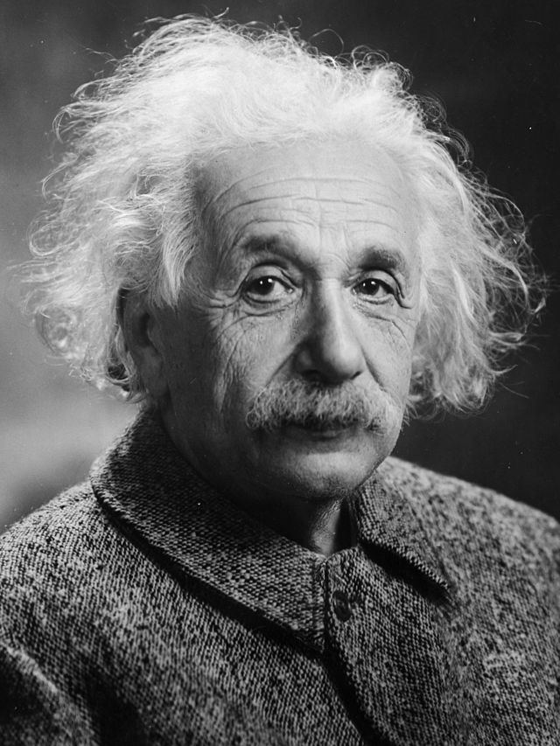
Simplicity
Everything should be made as simple as possible, but not simpler.
  Albert Einstein
Photograph by Oren Jack Turner, Princeton, licensed through Wikipedia

Slide 14
Parsimony
“…too few parameters and the model will be so unrealistic as to make prediction unreliable, but too many parameters and the model will be so specific to the particular data set so to make prediction unreliable.”
  Edwards, A. W. F. (2001). Occam’s bonus. p. 128–139; in Zellner, A., Keuzenkamp, H. A., and McAleer, M. Simplicity, inference and modelling. Cambridge University Press, Cambridge, UK.

Slide 15
Parsimony
Under fitting
model structure …included in the
residuals
Over fitting
residual variation
is included as if it were structural
Parsimony
Notes:
From Anderson

Slide 16
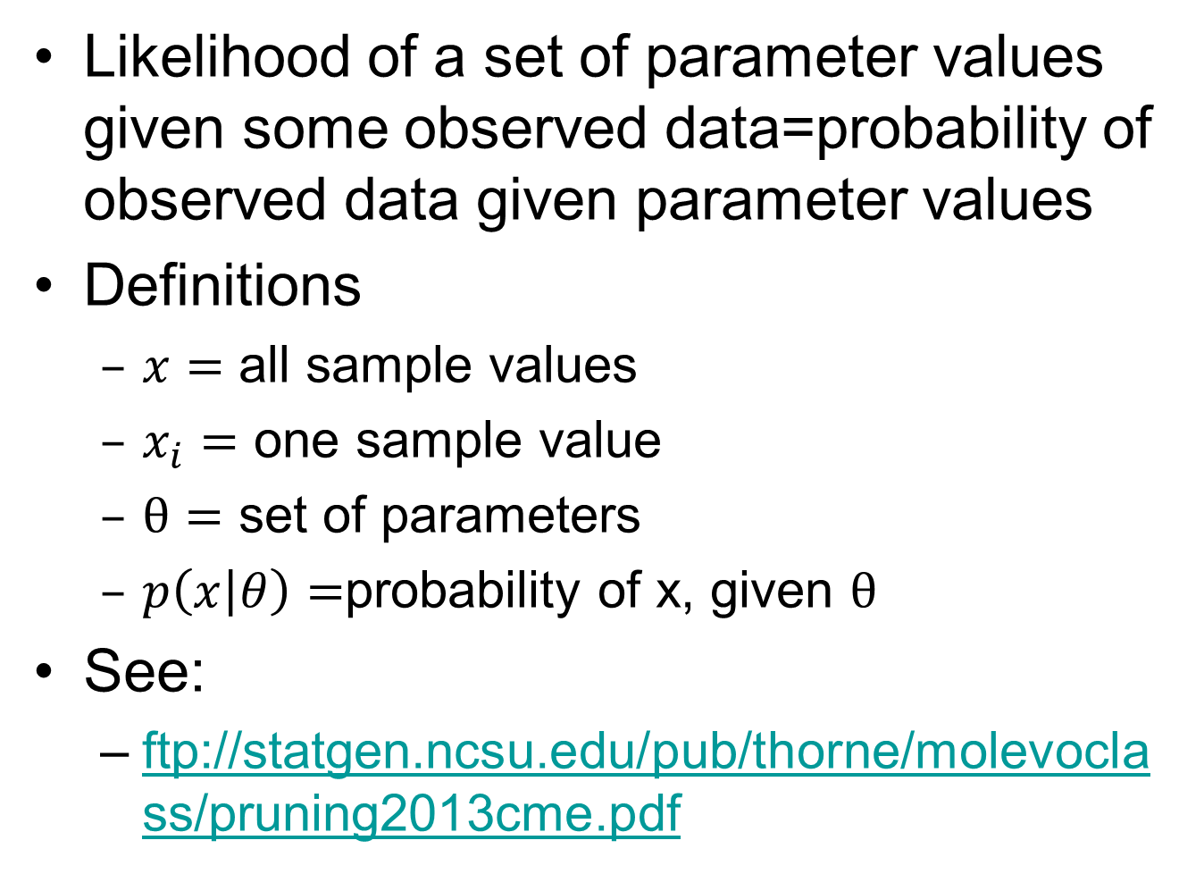
Likelihood
Likelihood of a set of parameter values given some observed data=probability of observed data given parameter values
Definitions
  $x=$ all sample values
  $x_{i}=$ one sample value
  $θ=$ set of parameters
  $p\left(x | θ\right)=$probability of x, given $θ$
See:
  ftp://statgen.ncsu.edu/pub/thorne/molevoclass/pruning2013cme.pdf

Slide 17
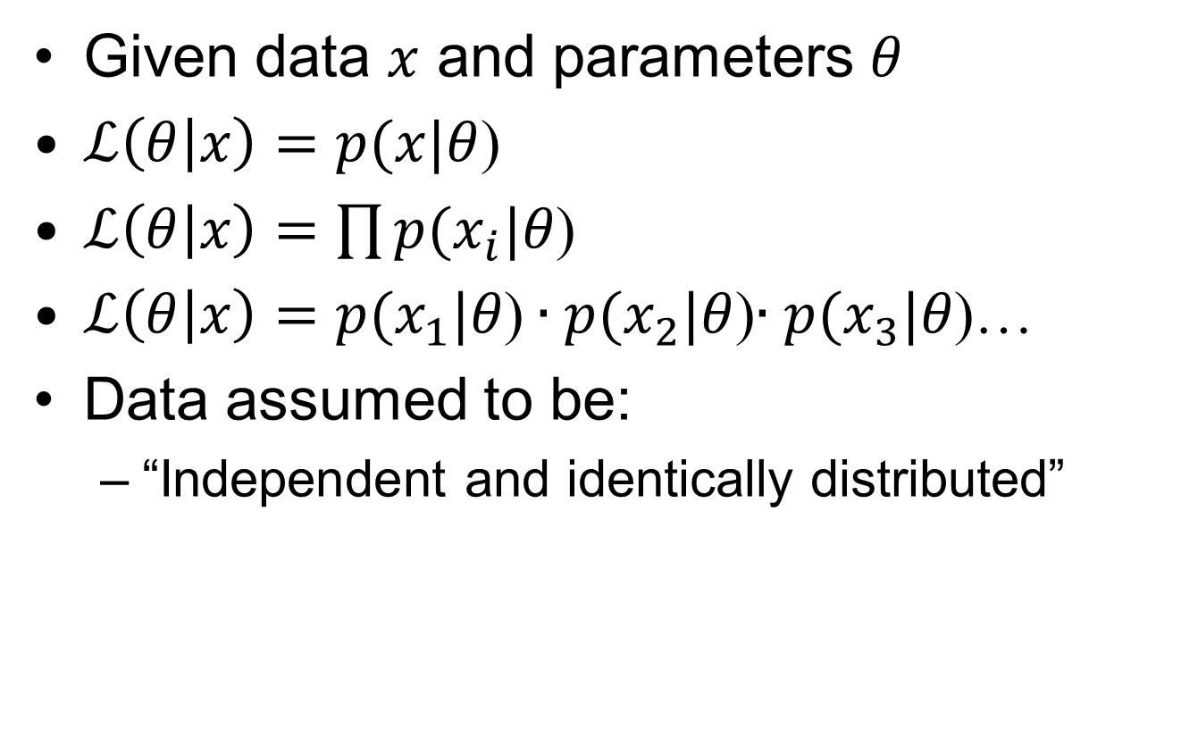
Likelihood

Slide 18
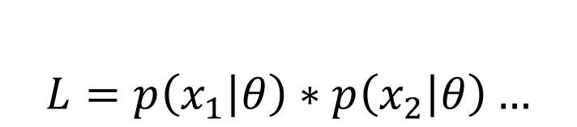
p(x) for a fair coin
$$L=p\left(x_{1} | θ\right)∗p\left(x_{2} | θ\right)…$$
0.5
Heads
Tails
What happens as we flip a “fair” coin?

Slide 19
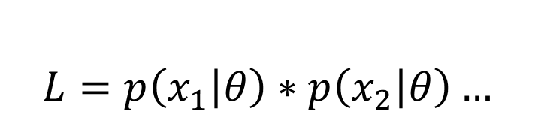
p(x) for an unfair coin
$$L=p\left(x_{1} | θ\right)∗p\left(x_{2} | θ\right)…$$
0.8
Heads
0.2
Tails
What happens as we flip a “fair” coin?

Slide 20
p(x) for a coin with two heads
$$L=p\left(x_{1} | θ\right)∗p\left(x_{2} | θ\right)…$$
1.0
Heads
0.0
Tails
What happens as we flip a “fair” coin?

Slide 21
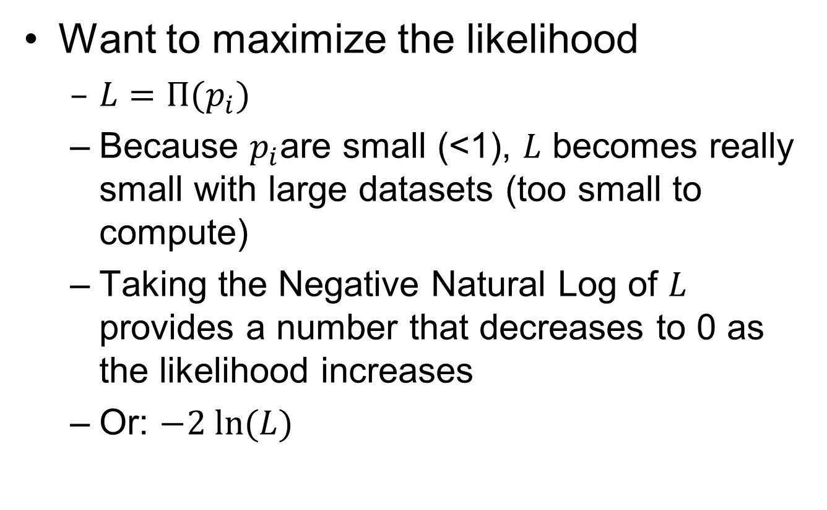
Maximum Likelihood
Want to maximize the likelihood
  $L=Π(p_{i})$
  Because $p_{i}$are small (<1), $L$ becomes really small with large datasets (too small to compute)
  Taking the Negative Natural Log of $L$ provides a number that decreases to 0 as the likelihood increases
  Or: $−2 ln⁡(L)$

Slide 22
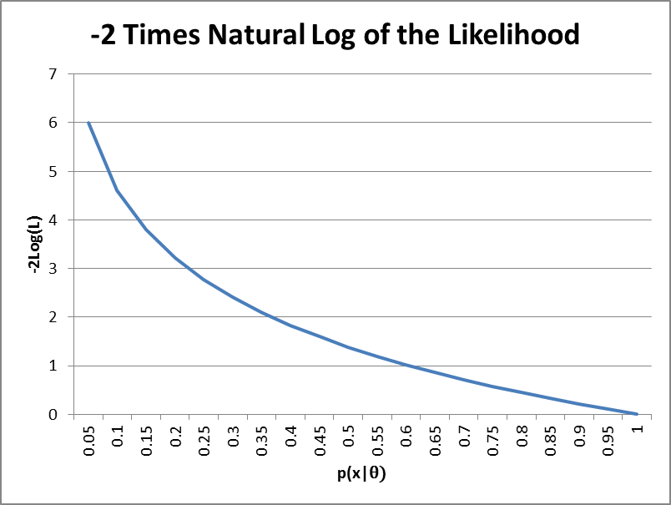
-2 Times Log Likelihood

Slide 23
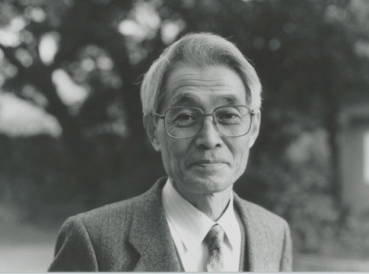
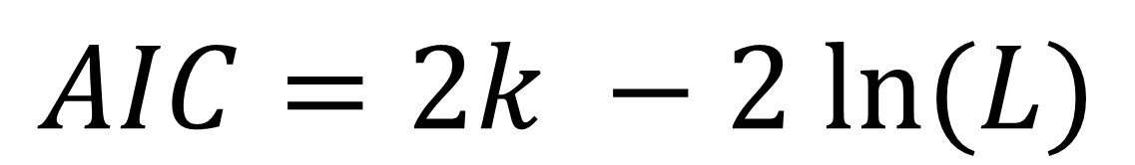
Akaike Information Criterion
AIC
K = number of estimated parameters in the model
L = Maximized likelihood function for the estimated model
$$AIC=2k −2 ln⁡(L)$$

Slide 24
AIC
Only a relative meaning
Smaller is “better”
Balance between complexity:
  Over fitting or modeling the errors
  Too many parameters
And bias
  Under fitting or the model is missing part of the phenomenon we are trying to model
  Too few parameters

Slide 25
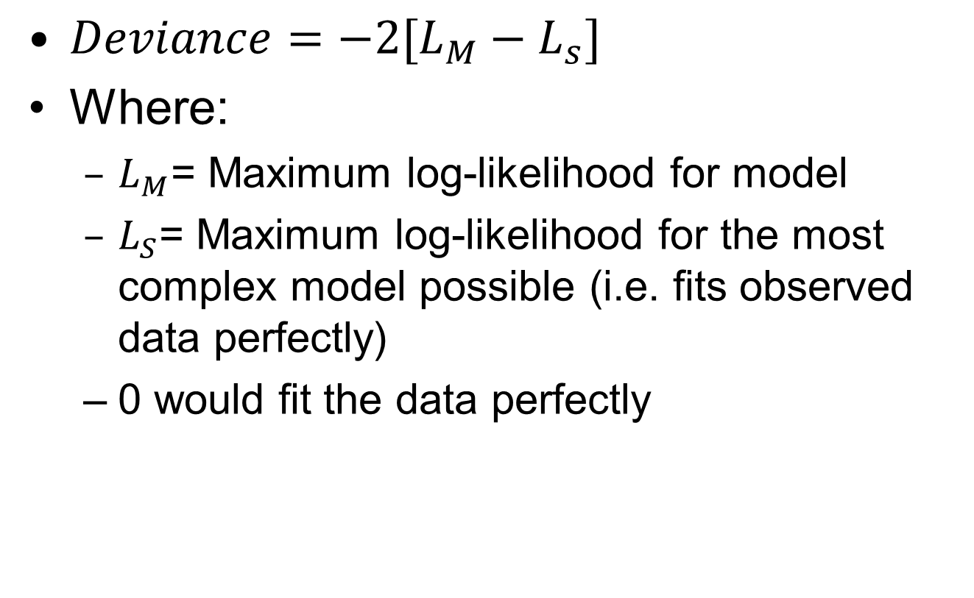
Deviance
$Deviance=−2[L_{M}−L_{s}]$
Where:
  $L_{M}$= Maximum log-likelihood for model
  $L_{S}$= Maximum log-likelihood for the most complex model possible (i.e. fits observed data perfectly)
  0 would fit the data perfectly

Slide 26

Degrees of Freedom
$N=$number of observations
$p=$number of parameters
Degrees of freedom = $N −p$

Slide 27
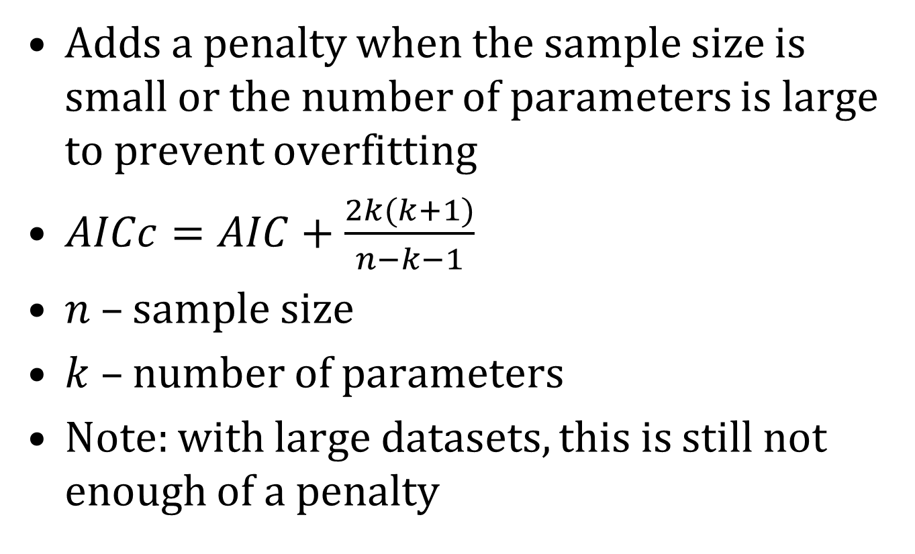
AICc
Adds a penalty when the sample size is small or the number of parameters is large to prevent overfitting
$AICc=AIC+\frac{2k(k+1)}{n−k−1}$
$n$ – sample size
$k$ – number of parameters
Note: with large datasets, this is still not enough of a penalty

Slide 28
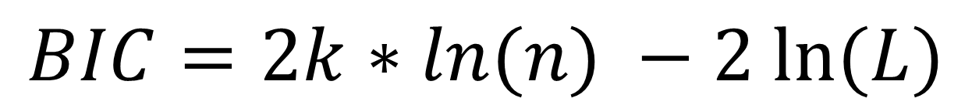
BIC
Bayesian Information Criterion
Adds n (number of samples)
$$BIC=2k∗ln(n) −2 ln⁡(L)$$

Slide 29
Validation: General Approach
Create the “default” model
Test the model by:
  Splitting into test and training data sets
  Train (fit) the model on the training data
    Inject error into response and covariants
  Validate the model against the test data
    Inject error into coefficients
  Create Maps
  Collect statistics: AIC, residuals, etc.
  Repeat until statistics stabilize
Summarize statistics

Slide 30
May be the same data
Field Data
Response, coordinates
Jackknife
Covariates
Direct or Remotely sensed
Predictors
Remotely sensed
Sample Data
Response, covariates
Qualify,
Prep
Qualify,
Prep
Qualify,
Prep
Random split?
Randomness
Inputs
Cross-Validation
Noise Injection
Outputs
Test Data
Training Data
Temp Data
Processes
Repeated
Over and Over
Build Model
Monte-Carlo
Randomize parameters
The Model
Sensitivity
Testing
Statistics
Validate
Predict
Randomness
Noise
Injection
Predicted Values
Uncertainty Maps
Summarize
Predictive Map

Slide 31
Specific Outputs
Charts:
  Scattergrams of response vs. independent variables with predicted output overlaid
  Histograms of residuals
  Others…
Performance Statistics:
  R², AIC, Deviance, etc.
An output raster (modeled surface)

Slide 32
Situation
Standard modeling methods need:
  Response variable
  Independent variables
  Tables (CSVs and Data Frames) work well
We also need:
  Maintain X, Y coordinates
  Build model from field/sample data
  Build predicted output for entire study area (and often other areas)

Slide 33
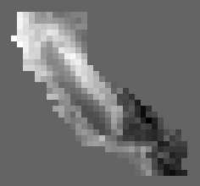

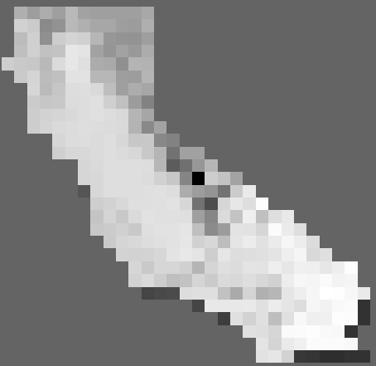
Field/Sample data
Typical
X | Y | MaxHeight | Temp
41.005405 | -122.48657 | 50 | 71
39.653127 | -123.33429 | 43 | 55
37.326406 | -119.70232 | 32 | 79
41.392173 | -122.03255 | 51 | 68
37.378509 | -119.17363 | 62 | 102
2. Build Model
Model
“Parameters”
Performance
Statistics
Independent Variable
1. Extract
5. Predict
6. Add To Data Frame
3. To Points
Modeled Surface
Attributes
X | Y | Temp | Predict
-123.677 | 41.61906 | 65 | 0.8
-123.344 | 41.61906 | 30 | 0.2
-123.011 | 41.61906 | 96 | 0.7
-122.677 | 41.61906 | 55 | 0.1
-122.344 | 41.61906 | 100 | 0.3
7. To
Raster

Slide 34
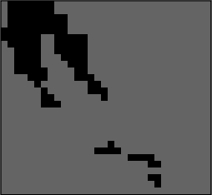
Have full set of presence points without absences
Field/Sample data
X | Y | Presence
40.89634 | -121.802 | 1
40.9877 | -122.117 | 1
40.9877 | -122.117 | 1
2. To Points
3. Extract
Attributes
X | Y | Temp | Presence | Predict
-123.677 | 41.61906 | 71 | 1 | 0.8
-123.344 | 41.61906 | 55 | 0 | 0.2
-123.011 | 41.61906 | 79 | 1 | 0.7
-122.677 | 41.61906 | 68 | 0 | 0.1
-122.344 | 41.61906 | 102 | 0 | 0.3
7. To
Raster
1. To Points
4. Build
the Model
6. Add To
Data Frame
Model
“Parameters”
5. Predict
Performance
Statistics
Independent Variable

Slide 35
Extra slides

Slide 36
Does likelihood from p(x) work?
If the likelihood is the probability of the data given the parameters,
and a response function provides the probability of a piece of data (i.e. probability that this is suitable habitat)
We can use the probability that a specific occurrence is suitable as the p(x|Parameters)
Thus the likelihood of a habitat model (while disregarding bias)
Can be computed by L(ParameterValues|Data)=p(Data1|ParameterValues)*p(Data2|ParameterValues)...
Does not work, the highest likelihood will be to have a model with 1.0 everywhere, have to divide the model by it’s area so the area under the model = 1.0
Remember: This only works when comparing the same dataset!

Slide 37
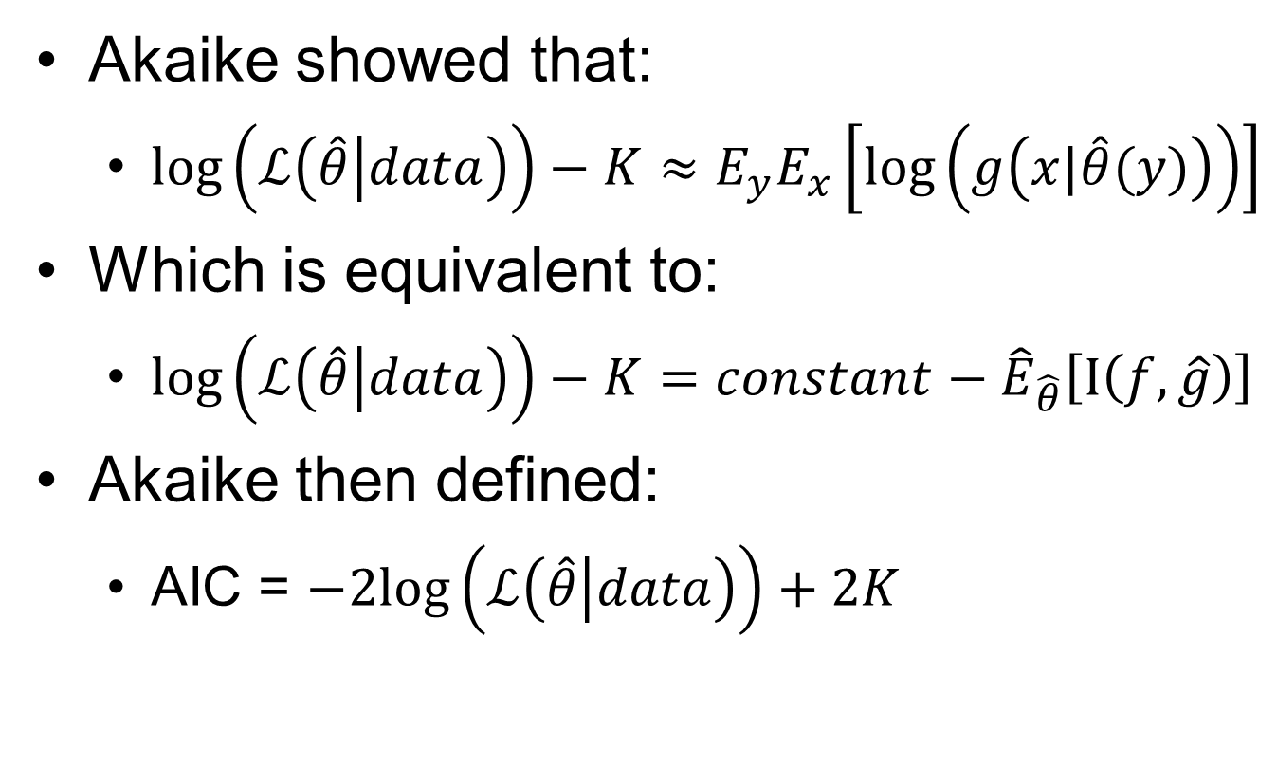
Akaike…
Akaike showed that:
  ${\log\left(ℒ\left(\hat{θ} | data\right)\right)−K≈E}_{y}E_{x}\left[\log\left(g\left(x|\hat{θ}(y)\right)\right)\right]$
Which is equivalent to:
  $\log\left(ℒ\left(\hat{θ} | data\right)\right)−K=constant−{\hat{E}}_{\hat{θ}}\left[I\left(f,\hat{g}\right)\right]$
Akaike then defined:
  AIC = $−2log\left(ℒ\left(\hat{θ} | data\right)\right)+2K$

Slide 38
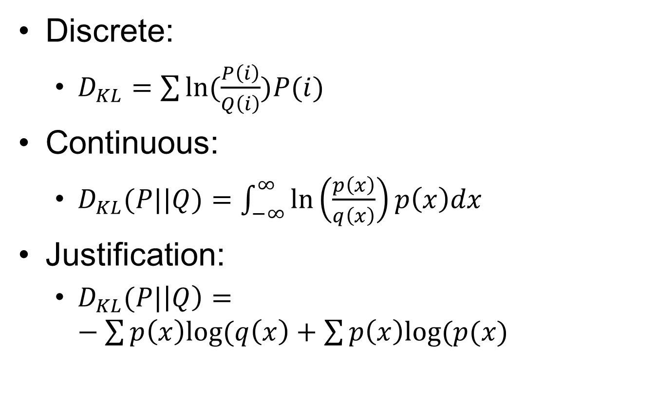
Discrete:
  $D_{KL}=\sum{ln⁡(\frac{P\left(i\right)}{Q\left(i\right)})P(i)}$
Continuous:
  $D_{KL}(P||Q)=\int_{−∞}^{∞}{\ln\left(\frac{p\left(x\right)}{q\left(x\right)}\right)p\left(x\right)dx}$
Justification:
  $D_{KL}(P|\left|Q\right)=−\sum{p\left(x\right)log⁡(q\left(x\right)+\sum{p\left(x\right)log⁡(p(x)}}$

Slide 39
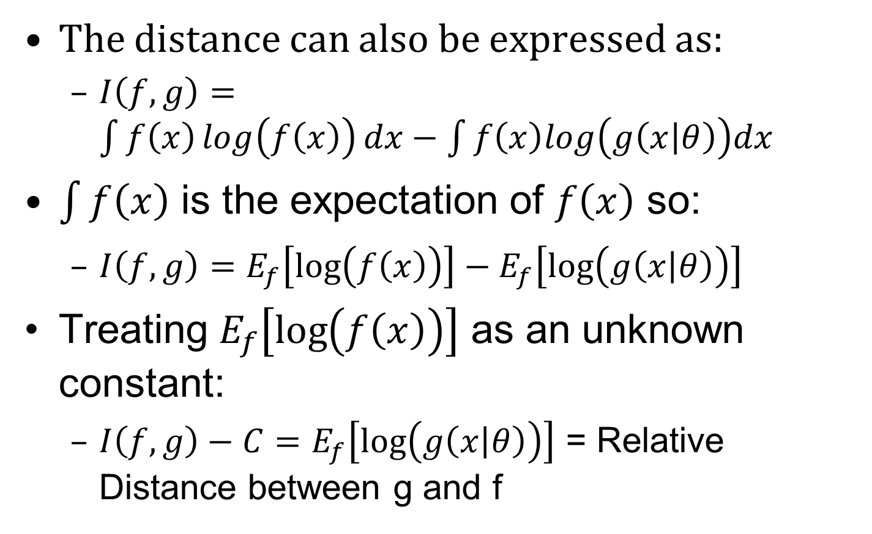
The distance can also be expressed as:
  $I\left(f,g\right)=\int{f\left(x\right)\log\left(f\left(x\right)\right)dx−\int{f\left(x\right)log\left(g\left(x | θ\right)\right)dx}}$
$\int{f\left(x\right)}$ is the expectation of $f\left(x\right)$ so:
  $I\left(f,g\right)=E_{f}\left[\log\left(f\left(x\right)\right)\right]−E_{f}\left[\log\left(g\left(x | θ\right)\right)\right]$
Treating $E_{f}\left[\log\left(f\left(x\right)\right)\right]$ as an unknown constant:
  $I\left(f,g\right)−C=E_{f}\left[\log\left(g\left(x | θ\right)\right)\right]$ = Relative Distance between g and f

